Slide 1


Module 4
Audit Committee’s Alleged Wrong-doing Function
Next

Slide 2

Five Modules
Audit Committee Training on roles of the audit committee
General Purpose and Function
External Auditor Function
Financial Reporting Function
Alleged Wrong-doing Function
Risks and Internal Control Function
Back
Next

Slide 3

Fraud
    What is fraud?
    What is the impact?
    What is the key strategy to prevent fraud?
    What is the Committee’s role?
Back
Next

Slide 4
3
Definition of Fraud
    Act or course of deception; an intentional concealment; omission and perversion of the truth.
Intentional
Violates the fiduciary duties
Purpose is for a direct or indirect financial gain
Costs (assets, revenues or reserves)
Back
Next

Slide 5
18 months average duration
The median
loss for small
and large organization
was the same
$200K range.
$118 K median loss for local government
59% recovered nothing
4
Back
Next
Notes:
Based on the 2018 Global Fraud report “Report to the Nations” – government version
The median duration — the amount of time from when the fraud commenced until it was detected — for the fraud cases reported to us was 18 months.
The median loss caused by the frauds for Canadian was $200K USD. For government the median loss 118k - 92k for local government, prov 100K and fed 200K. Additionally, one fifth of the cases involved losses of at least $1 million. This can be especially devastating to small organizations.
Smallest organization (fewer than 100) and large org 10,000+ employees had the same median loss 210K and 213 k respectively. This loss has a more significant impact on the smaller organization.
For gov- 72% of the cases were referred for criminal prosecution of this only 54% pleaded or found guilty and another 34% were not prosecuted.
Only 19% recovered all losses, 23% partial recovery with 59% received nothing

Slide 6
5
Why do people commit fraud?
Fraud is likely to happen when there is opportunity, internal/external pressure (motivation), and the ability to rationalize one’s actions.
Back
Next

Slide 7
Fraud Triangle
6
Pressures
Opportunity
Internal/External Pressures
Addiction (drugs, gambling)
Financial pressures
Know a way to use their position to commit fraud and believe there is a low risk of getting caught.
Rationalization
Fail to see the criminal nature, feels it is justified.
Just borrowing; I planning to pay it back.
The organization I work for is under-paying me.
Everyone is doing it.
Back
Next
Notes:
The Fraud Triangle– There are three factors that must be present 1. Motive/Pressure – There usually is some internal or external pressure to commit the fraud example like addition, financial pressures and inability to pay bills or just pressures to just keep up the Jones; 2, Opportunity -Know a way to use their position to commit fraud and believe there is a low risk of getting caught. And 3 they can rationalize the fraud. They do not see the action as criminal it is justified. I am just borrowing the money I am going to pay it back, the organization is underpaying or not paying me for all the extra time and work I do and everyone is doing it so it is okay.
Interesting to not that it is almost gender neutral…54.7% involve males while 45.3% involve females
There Opportunity the person knows a way to use their position to commit fraud and believe there is a low risk of getting caught.

Slide 8
7
44%
Owners/executives
are more likely to collude with others
Collusion schemes tend to be more costly than single-perpetrator frauds.
34%
19%
3%
Employee
Manager
Owner/executive
Other
$50,000
$150,000
$189,000
Back
Next
$850,000
Notes:
This is for overall
For government entities 68% of fraud is committed by men and the losses caused by men were 4 times larger.
Fraudsters who had been with their organization for more than 5 years stole significantly more
Only 5% of fraudsters has a prior fraud conviction for Cdn data0%
85% of the cases the person displayed one of the behavioural red flags

Slide 9
8
Occupational Fraud
    Internal Fraud - Occupational Fraud – fraud that is committed against an employer by an employee or management
Back
Next
Notes:
Although the types of fraud that affect organizations vary widely, the research notes that occupational fraud is the most likely
Occupational Fraud is the use of one’s occupation for personal enrichment through the deliberate misuse or misapplication of the employing organization’s resources or assets
Put more simply, occupational fraud is a fraud committed against an employer by an employee or management.
Owners/executives only accounted for 19% of all cases, but they caused a median loss of $500,000.
Employees, conversely, committed 42% of occupational frauds but only caused a median loss of $75,000.
Managers ranked in the middle, committing 36% of frauds with a median loss of $130,000.
By its very nature, this form of fraud is a threat to all organizations that employ individuals to perform their business functions.

Slide 10
9
Main Types of Occupational Fraud
    Asset Misappropriation
    Corruption
    Financial Statement Fraud
Back
Next

Slide 11
9
10
Back
Next

Slide 12
Types of Occupational Fraud
11
Asset Misappropriation
Employee steals or misuses its organization’s assets (cash and noncash).
    Asset Misappropriation Schemes:
    Billing
    Skimming
    Cash Larceny
    Expense Reimbursement
    Cheque Tampering
Back
Next

Slide 13
Types of Occupational Fraud
12
Corruption
Employee misuses their position in order to gain a direct or indirect benefit.
    Example of Corruption Fraud:
      Conflict of Interest
      Bribery
      Illegal Gratuities
      Economic Extortion
Back
Next

Slide 14
Types of Occupational Fraud
13
Financial Statement Fraud
    Deliberate misrepresentation of an organization financial condition by intentionally causing a misstatement or omission of material information in the financial statements.
    Manipulating timing of recognition of revenues or expenditures
    Falsifying entries
Back
Next

Slide 15
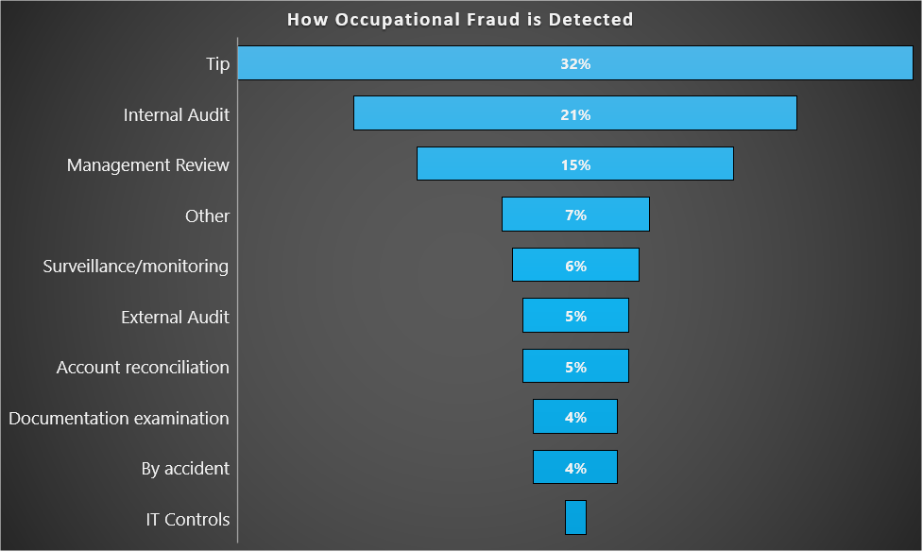
14
Back
Next
1%

Slide 16

    Missing documents;
    Missing asset (inventory shrinkage, cash shortages);
    Large number of adjusting entries;
    Multiple payments;
    Frequent complaints
    Overriding internal controls;
15
What are some warnings of potential fraud?
Back
Next

Slide 17
16
OVERALL
INTERNAL CONTROL WEAKNESSES
WERE RESPONSIBLE FOR NEARLY
HALF OF FRAUDS
Back
Next

Slide 18
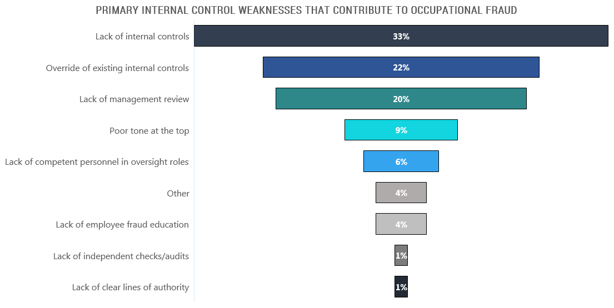
17
Back
Next

Slide 19
18
Key Strategies
    Code of conduct
    Employee support programs
    Clear line of authority
    Fraud program (policy, reporting, education)
    Robust internal control system (independent reviews); and responses to internal control concerns monitored
    Effective oversight and monitoring
    Requesting periodic updates from management on allegation/complaints
Back
Next

Slide 20
19
Back
Next
Notes:
Government version 2018
The chart shows how the impact of an anti-fraud control relates to the median loss and duration of the fraud
The presence of several controls at a government organization would decrease both the amount of the loss and duration of a fraud.

Slide 21
20
Your Role Regarding Alleged Wrong-doing
    Ensuring management implements robust internal controls (independent reviews) and responds to internal control concerns noted.
    Ensuring management maintains a fraud program (policy, reporting, education);
    Requesting periodic updates from management on allegation/complaints:
      nature and volume of allegations/complaints reported; and
      responses to allegations/complaints.
    Support code of conduct
Module 5 will provide more information on the next steps regarding Internal Controls.
Back
Next
Notes:
Ensure there is a process to review and respond to complaints or allegations of wrong-going;
Review complaints or allegations of wrong-going; and
Provide advise to council with respect to complaints or Ensure there is a process to review and respond to complaints or allegations of wrong-going;
Review complaints or allegations of wrong-going; and
Provide advise to council with respect to complaints or allegations pf wrong-going.

Slide 22

The Quiz
  Questions
Back
Next
Notes:
What happens if there is a disagreement between the auditor and management?

Slide 23

The Director of Finance exaggerates the funding claims for a government grant and claims more expenses than the municipality incurred. Is this fraud?
Yes or No
Back
Next
Notes:
5(3)(d) Meeting Requirements
(I)An audit committee should convene whenever circumstances demand such a meeting; however, the committee must meet at least twice in each fiscal year.
(ii)It is recommended the audit committee meet at least four times, and the meeting should coincide with the stages of the audit. The following topics are recommended to be included on the audit committee’s agendas
a

Slide 24

Yes
The Director of Finance is committing fraud against the government by falsifying claims.
Back
Next

Slide 25
Jane is responsible for the purchasing and receiving for the municipality. In her last order, she included extra items which she took home for her family to use. Is this fraud?
Yes or No
Back
Next
Notes:
5(3)(d) Meeting Requirements
(I)An audit committee should convene whenever circumstances demand such a meeting; however, the committee must meet at least twice in each fiscal year.
(ii)It is recommended the audit committee meet at least four times, and the meeting should coincide with the stages of the audit. The following topics are recommended to be included on the audit committee’s agendas

Slide 26
Yes
Jane is committing occupational fraud. She is stealing assets from her employer.
Back
Next
Notes:
Per the “Municipal Government Act” regulations 5(1)(b) municipalities and villages are required to appoint an auditor who is registered by the Department of Municipal Affairs.
No firm or partnership or person can act as, or exercise or perform any of the duties of, an auditor for a municipality or village unless they are registered as a municipal auditor pursuant to the provisions of Section 457 of the Municipal Government Act.

Slide 27
Henry, the Manager of Finance, records a higher revenue amount in the financial statements due to an incorrect adjusting entry. Is this fraud?
Yes or No
Back
Next
Notes:
5(3)(d) Meeting Requirements
(I)An audit committee should convene whenever circumstances demand such a meeting; however, the committee must meet at least twice in each fiscal year.
(ii)It is recommended the audit committee meet at least four times, and the meeting should coincide with the stages of the audit. The following topics are recommended to be included on the audit committee’s agendas
(iii)There is a requirement that audit committee meeting dates be specifically established and agendas developed to address its terms of reference and responsibilities.
(iv)There will on occasion, be a need for the auditor to meet with the audit committee, without any appointed officials present. This would be accommodated through a request by
either the committee or the auditor to one another.

Slide 28
No
For the action to be considered financial statement fraud, it would have to be a deliberate misrepresentation of an organization’s financial condition by intentionally causing a misstatement or omission of material information in the financial statement. This was an error.
Back
Next
Notes:
Per the “Municipal Government Act” regulations 5(1)(b) municipalities and villages are required to appoint an auditor who is registered by the Department of Municipal Affairs.
No firm or partnership or person can act as, or exercise or perform any of the duties of, an auditor for a municipality or village unless they are registered as a municipal auditor pursuant to the provisions of Section 457 of the Municipal Government Act.

Slide 29
A municipality’s annual financial statement audit will uncover any fraud.
True or False
Back
Next
Notes:
5(3)(d) Meeting Requirements
(I)An audit committee should convene whenever circumstances demand such a meeting; however, the committee must meet at least twice in each fiscal year.
(ii)It is recommended the audit committee meet at least four times, and the meeting should coincide with the stages of the audit. The following topics are recommended to be included on the audit committee’s agendas
a.

Slide 30
False
Only 6% of frauds are detected by an external audit.
Back
Next
Notes:
Per the “Municipal Government Act” regulations 5(1)(b) municipalities and villages are required to appoint an auditor who is registered by the Department of Municipal Affairs.
No firm or partnership or person can act as, or exercise or perform any of the duties of, an auditor for a municipality or village unless they are registered as a municipal auditor pursuant to the provisions of Section 457 of the Municipal Government Act.

Slide 31
Entities should have several controls to help prevent and detect fraud. Which one would not be considered a control?
Code of conduct
Hotline
External audit of internal controls
Surprise audits
Anti-fraud policy
Employee support programs
Formal fraud risk assessments
Back
Next

Slide 32
All would
Each item may have a different level of impact. It is important for organizations to have several controls in place to help prevent and detect fraud.
Back
Next
Notes:
Per the “Municipal Government Act” regulations 5(1)(b) municipalities and villages are required to appoint an auditor who is registered by the Department of Municipal Affairs.
No firm or partnership or person can act as, or exercise or perform any of the duties of, an auditor for a municipality or village unless they are registered as a municipal auditor pursuant to the provisions of Section 457 of the Municipal Government Act.

Slide 33

You have successfully completed Module 4.
You can now proceed to the final Module 5.
Back
Next

